Slide 1
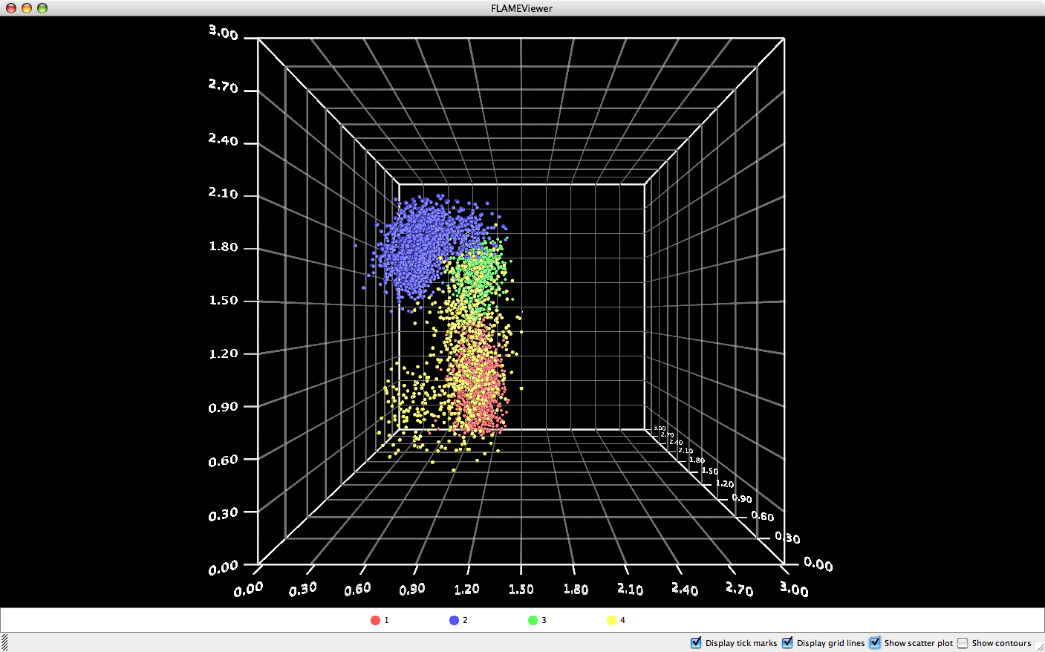
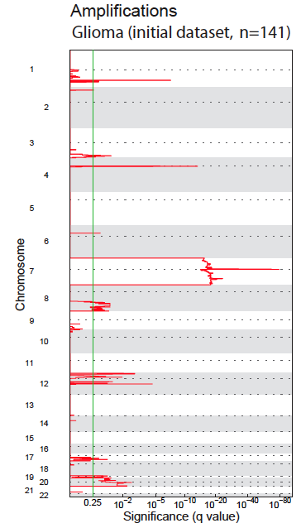
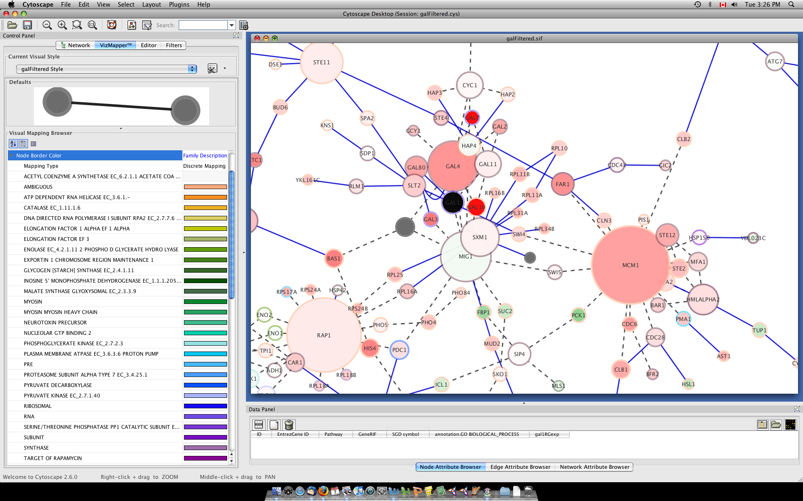
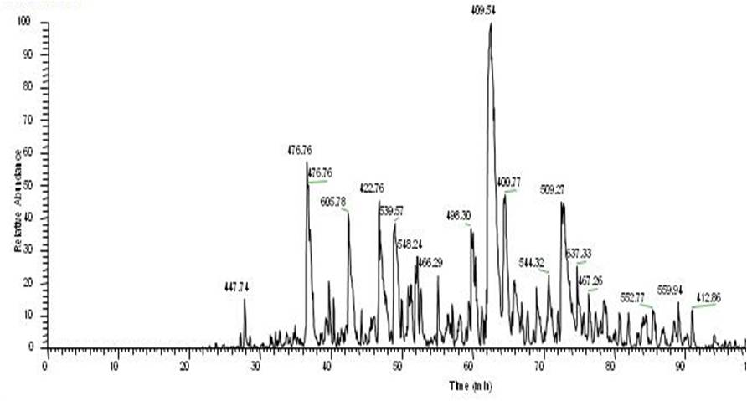
Other GenePattern Features
Sequence Variation
Analysis
Flow Cytometry
Network Analysis
Proteomics
Notes:
‹#›
In addition to what you have seen today GenePattern has many other analysis in several domains such as flow cytometry, network analysis, sequence variation and proteomics. Also, not shown here, we have just started adding spatial transcriptomics modules based on the python spatialGE package.

Slide 2

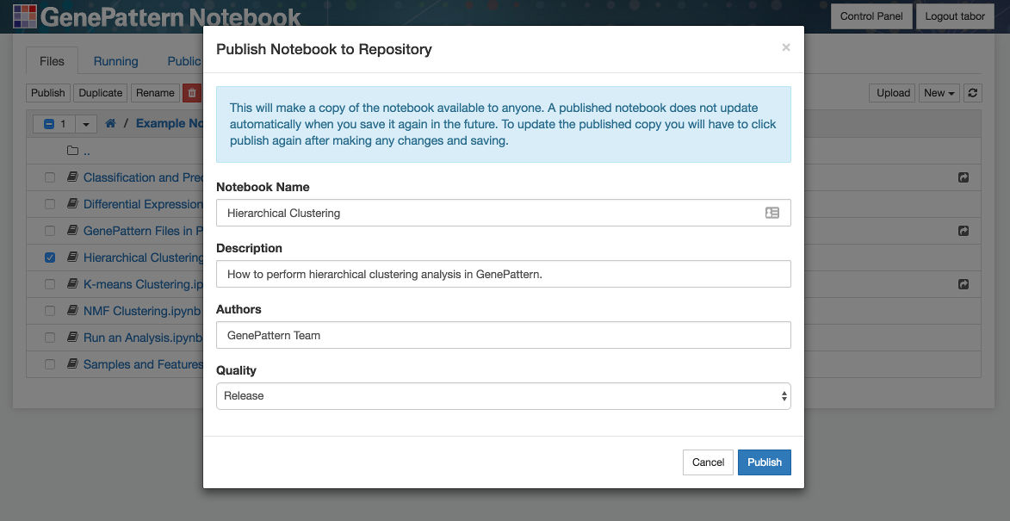
Publish Your Notebooks
Publish your own notebooks on the g2nb workspace.
Share notebooks with others.
Notes:
Earlier we walked through browsing the list of available public notebooks.
.
The notebooks in this list were contributed by some combination of the GenePattern team and the GenePattern Notebook community.
.
In fact, anyone can share their own public notebooks in this way. This is a good way to share your research with others. It can be used to accompany a paper or other publication.

Slide 3
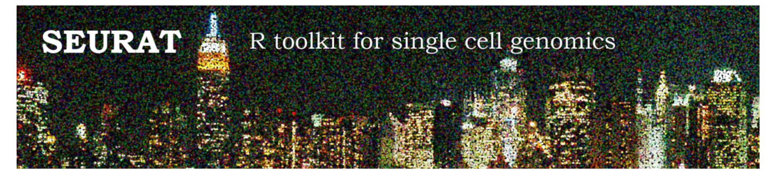
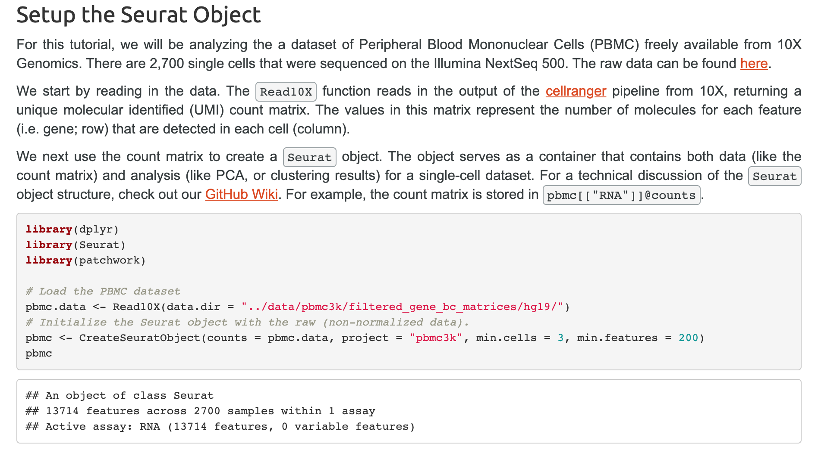
The Seurat GenePattern Notebook
https://satijalab.org/seurat/v3.1/pbmc3k_tutorial.html
Notes:
A number of single cell software tools provide analysis workflows in which users examine intermediate results at each step as part of an interactive process.
The developers of the Seurat toolkit in the Raul Satija lab authored a tutorial walking users through downloading, preprocessing, clustering, and performing differential expression on a data set of peripheral blood mononuclear cells.
We adapted this tutorial to the GenePattern Notebook Environment.
Here, you can see an example of a module that can load many the single cell file types, removing the need for users to configure their analyses for different formats.
This particular cell loads the single cell data in any of these formats and displays a visual representation of various common quality control metrics used for filtering single cell data.

Slide 4
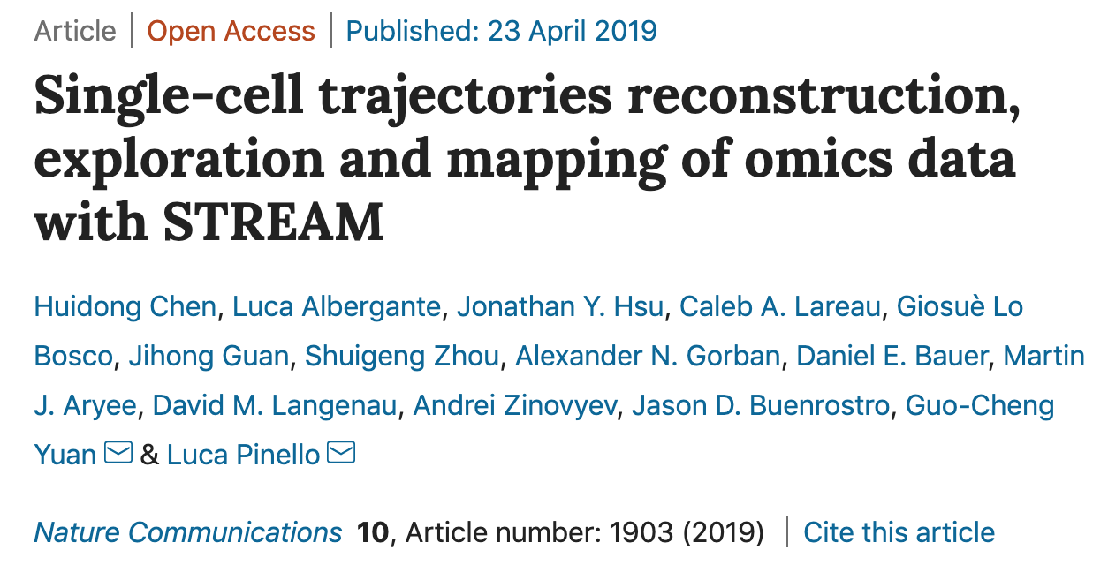
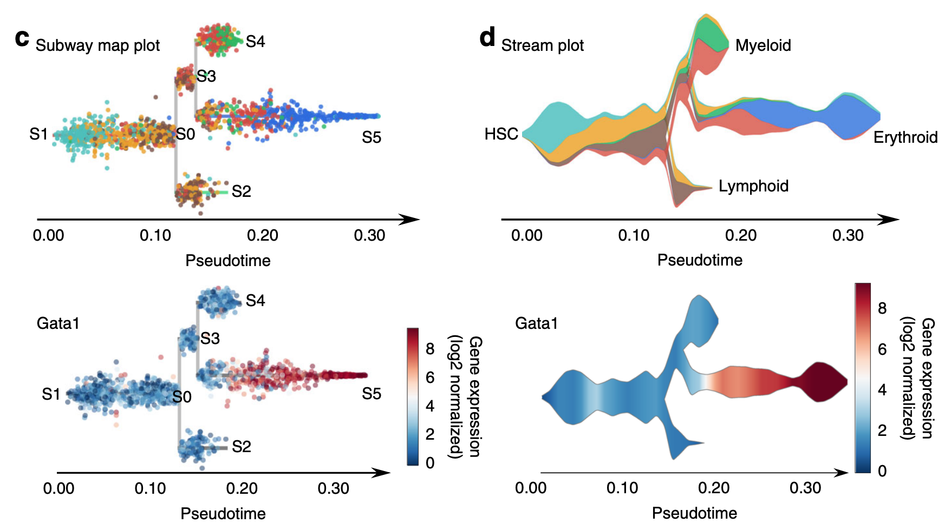
The STREAM Module and Notebook
Notes:
We have also implemented a pseudotime method called STREAM from the lab of Luca Pinello, using GenePattern modules and notebooks. Pseudotime analyses use techniques such as dimensionality reduction and applications of graph theory to identify these processes in the data and order the cells along a pseudotime trajectory.
As a note, in this ordering, the distance between one cell and another does not indicate a difference in terms of real units of time. It only indicates which cell comes after another in the sequence of a specific biological process. STREAM uses a method called Modified Locally Linear Embedding to build pseudotime trajectories.
On the left, you can see an example of STREAM's intuitive pseodotime representations, which the authors call Subway plots. In these plots, you can see both the different branches of the trajectory as well as the density of cells along the trajectory. The video on the right shows how the image files generated by one of the STREAM modules can be downloaded and displayed in the notebook using just a couple of clicks.

Slide 5
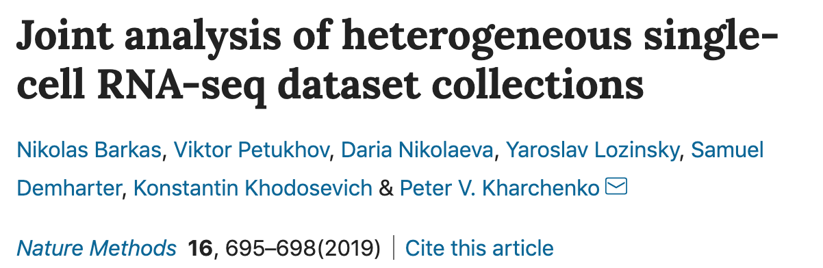
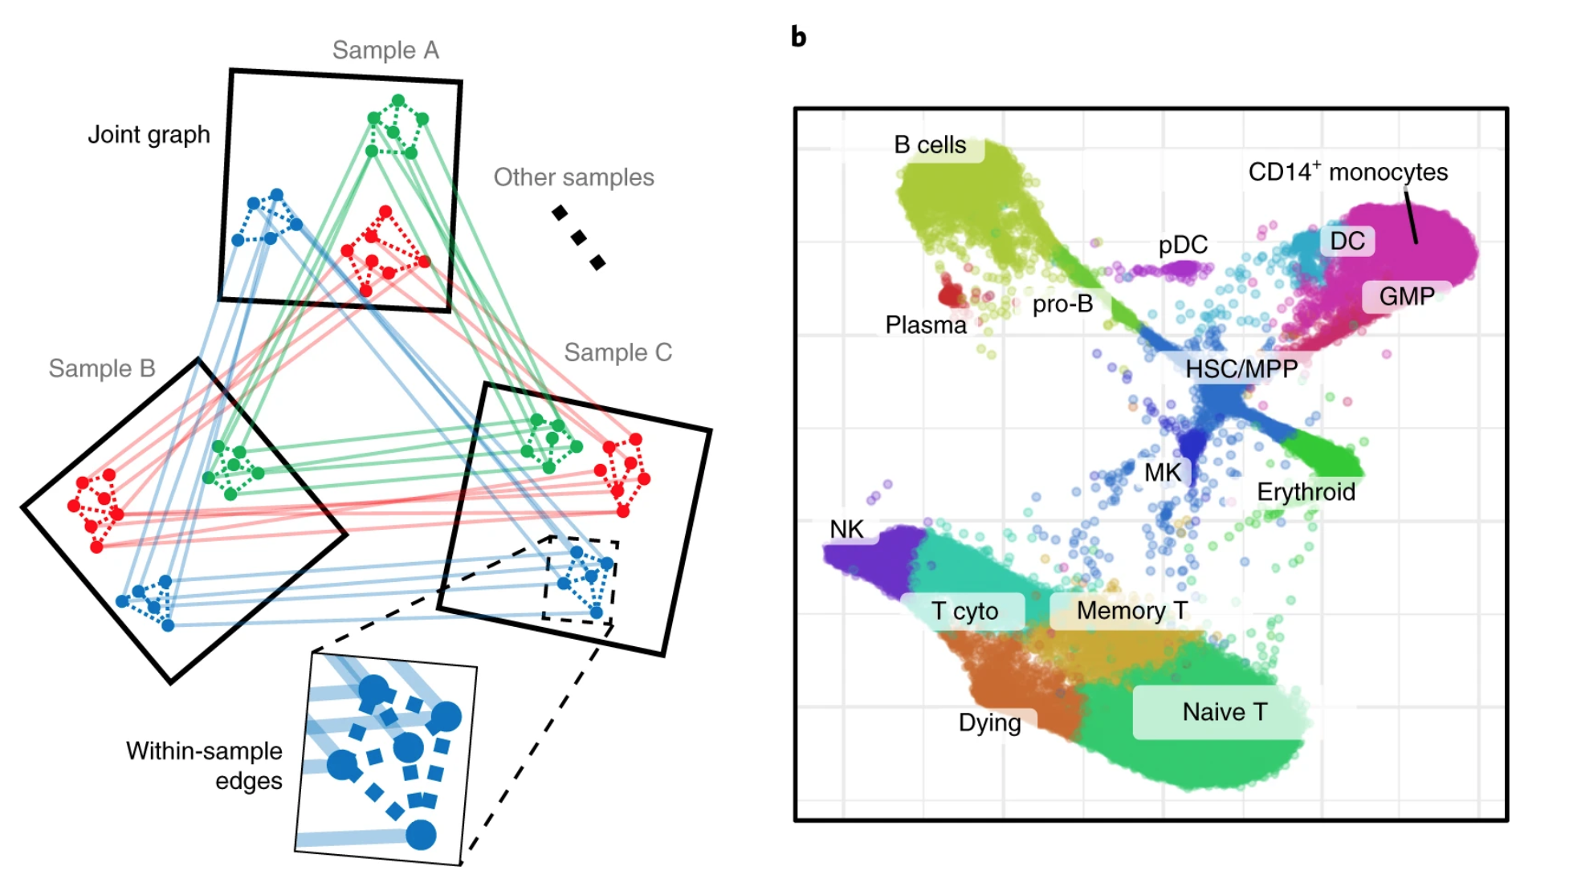
The CONOS Module and notebook
Notes:
As the volume of publicly available single cell data has increased in recent years, many researchers are focused on similar topics, such as immune cell and tumor interactions. There is growing interest in being able to harmonize or align different datasets that were collected in different labs or slightly different experimental conditions, but that still in theory describe similar biology or are expected to contain similar populations of cells.
CONOS, from the lab of Peter Kharchenko, is one such algorithm that uses a clustering and graph-based approach to link populations of similar cells from different experiments. We will soon make available a notebook that encompasses this workflow, utilizing GenePattern modules to performe the heavy lifting in the cloud while enabling users to interact with the results and configure and generate plots in real time.

Slide 6
GenePattern Python Library
Control a GenePattern server via Python
Automatic integration with GenePattern cell data
import gp
# Create a GenePattern server proxy instance
gpserver = gp.GPServer('http://localhost:8080/gp','myusername', 'mypassword')
# Obtain GPTask by module name
module = gp.GPTask(gpserver, "PreprocessDataset")
# Load module parameter data
module.param_load()
# Create a job specification
job_spec = module.make_job_spec()
# Upload a file to the server
uploaded_file = gpserver.upload_file("file_name", "/path/to/the/file/file_name")
job_spec.set_parameter("input.filename", uploaded_file.get_url())
# Submit the job to the GenePattern server
job = gpserver.run_job(job_spec)
Notes:
Under the cover, all GenePattern cells use the GenePattern Library. This library allows a user to set analysis parameters, launch GenePattern jobs, retrieve the results and import the data in a way that can be used with other popular Python libraries.
.
For example, you can run an analysis in GenePattern, retrieve the results and then use that data with Python libraries such as matplotlib, scikit-learn or pandas.
.
That is, GenePattern doesn’t import any limitations on you. If you can write code, you can use the library to perform whatever analysis you want.
.
And here you can see a bit of example code up on the screen.

Slide 7
Resources
TOOL | URL
GenePattern | www.genepattern.org
g2nb | www.g2nb.org
IGV | www.igv.org
GSEA and MSigDB | www.gsea-msigdb.org

Slide 8


Keep in touch!
Online forum for feature requests, bug reports, and general help | https://groups.google.com/g/genepattern-help
Mailing list to receive GenePattern news | www.genepattern.org/gp_mail.html
X/Twitter | @GenePattern
Mastodon | genepattern

Slide 9
Our Team
Anthony Castanza
Edwin Huang
Forrest Kim
Ted Liefeld
Michael Reich
Jim Robinson
Thorin Tabor
Pablo Tamayo
Helga Thorvaldsdottìr
Alex Wenzel
PI
Jill P.Mesirov
www.mesirovlab.org

